Slide 1


DIGISIM PART 2
PROJECT MEGAMUX TRACKER BY TEAM SSS

Slide 2
AGENDA
NAME MEANING
BASIC IDEA
APPROACH
SUBCIRCUITS INVOLVED
SPECIAL FEATURES
COST TABLE

Slide 3
NAME MEANING
PROJECT MEGAMUX TRACKER HAS GOT ITS NAME DUE TO HIGH USAGE OF MULTIPLEXER(MUX).
TRACKER SINCE IT TRACKS THE LEAST TIME SPENT AT A SPECIFIC GHAT/ADDRESS.

Slide 4
BASIC IDEA
USES TWO PIPO REGISTERS FOR TAKING INPUT
FIRST REGISTER TAKES US TOWARDS THE RIGHT TILL HEAD IS REACHED
NOW, SECOND REGISTER TAKES US TO LEFT TILL TAIL IS REACHED.
THE SUBCIRCUIT FINDER KEEPS TRACK OF THE MINIMUM TIME SPENT AND ALSO THE RESPECTIVE ADDRESS WHIH KEEPS ON BE UPDATING AND BECOMES CONTANT AFTER A CERTAIN TIME.

Slide 5
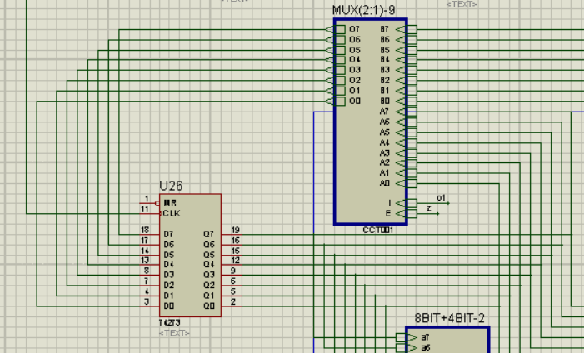
APPROACH
INPUT
THE INPUT WHICH IS THE STARTING ADDRESS MUST BE ENTERED IN BOTH OF THE PIPO D REGISTERS AS INITIAL VALUE
THE INPUT OF ONE OF THE REGISTERS IS KEPT IN A
LOOP SO THAT ITS VALUE IS STORED TILL THE TIME THE
OTHER REGISTER REACHES THE HEAD/TAIL.

Slide 6
APPROACH
PROCESS
TWO CLOCKS ARE MAINTAINED IN CIRCUIT CLOCK AND CLK-1(MADE FROM CLOCK ITSELF).
IN FIRST HALF CYCLE OF CLK-1, TIME SPENT AT THAT GHAT(X) IS EXTRACTED FROM ROM AND FEEDED INTO FINDER.
IN SECOND HALF CYCLE OF CLK-1, WE ADD 1 TO X USING ADDER AND ACCESS THE DATA AT X FROM ROM WHICH IS NOW TAKEN AS THE ADDRESS OF THE NEXT GHAT VISITED.
NOW THE REGISTER GETS UPDATED IN THE NEXT STATE TO ADDRESS X+2.
HENCE, THE FREQUECY OF THE CLOCK ATTACHED TO REGISTER IS DOUBLE OF THAT OF CLK-1 AS TWO TASKS HAVE TO BE COMPLETED BEFORE THE VALUE IN THE REGISTER GETS UPDATED.

Slide 7
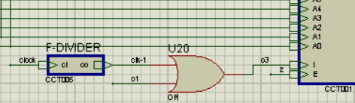
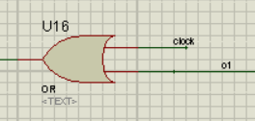
APPROACH
PROCESS
PROCESS CONTINUES TILL DATA EXTRACTED BECOMES 255 AND THEN REGISTER IS MADE TO FREEZE.
THE ABOVE IS DONE BY FREEZING CLOCK INPUT OF D REGISTER AND MUX USING THE BELOW ARRANGEMENT.
FOR MUX FOR REGISTER

Slide 8
APPROACH
PROCESS
PROCESS CONTINUES TILL DATA EXTRACTED BECOMES 255.
THE ABOVE IS DONE BY FREEZING CLOCK INPUT OF D REGISTER AND MUX USING THE BELOW ARRANGEMENT.
NOW THE SAME PROCESS IS REPEATED FOR THE OTHER REGISTER WHICH IS ENABLED BY O1(OUPUT OF COMPARATOR IN CYCLE OF FIRST REGISTER)
WHEN 255 IS AGAIN EXTRACTED THE PRESENT REGISTER IS ALSO STOPPED BY OUTPUT OF COMPARATOR ATTACHED TO THE PRESENT REGISTER.
FINAL RESULT IS THEN DISPLAYED.

Slide 9
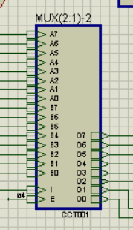
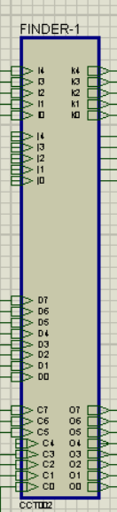
SUBCIRCUITS INVOLVED
2:1 EXPANDED MULTIPLEXER FOR 8 BITS
FINDS MINIMUM TIME SPENT AND ALSO RESPECTIVELY STORES THE CURRENT MINIMUM DATA AND CORRESPONDING ADDRESS

Slide 10
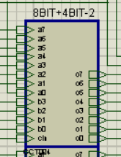
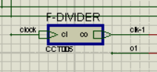
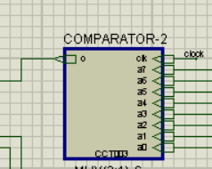
SUBCIRCUITS INVOLVED
8BIT + 4BIT ADDER
DIVIDES CLOCK FREQUENCY BY 2 WITH HELP OF JK FF
COMPARES EXTRACTED DATA FROM ROM WITH 255

Slide 11
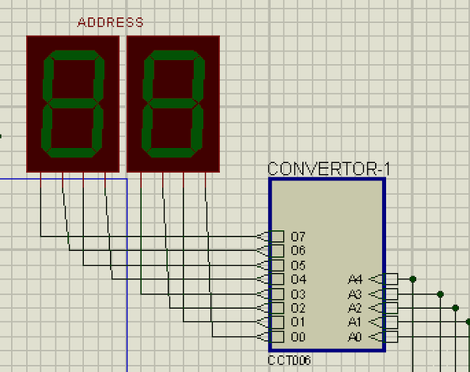
SUBCIRCUITS INVOLVED
BINARY TO BCD DISPLAY COVERTOR
CONVERTS BINARY NUMBER TO A FORM IN WHICH 2 DIGIT NUMBERS CAN BE DISPLAYED ON 7 SEG BCD DISPLAY.

Slide 12

HIGHLIGHTS
USE OF SINGLE ROM ONLY
OPTIMIZATION OF SINGLE CLOCK
OPTIMIZATION OF COST BY USE OF MUX

Slide 13
COST TABLE
COMPONENT | COUNT | COST
ROM | 1 | 75
CLOCK | 1 | 40
MUX | 6 | 12
ADDER | 4 | 8
74273 | 4 | 16
COMPARATOR | 6 | 12
LOGIC GATE(½ INPUT) | 26 | 2.6
D FF | 2 | 2
JK FF | 1 | 1
TOTAL |  | 168.6

Slide 14

Thank You!
-ANIRUDH & SAHIT

